Slide 1
How to best use these slides…
View the PPT as a slide show
Then click through every step
Mouse clicks will advance the slide show
Left/right arrow keys move forward/backward
Mouse wheel scrolling moves forward/backward
When a question is posed, stop and think it through, try to answer it yourself before clicking
If you have questions, use PS discussion boards, email me, and/or visit us in a Teams class session!

Slide 2
LESSON 7.2b
Graphing Translated Rational Functions

Slide 3
Today you will:
Learn how translations apply to rational functions
Graph translated rational functions
Practice using English to describe math processes and equations

Slide 4
Core Vocabulary:
Rational function, p. 366
Previous:
Domain
Range
Asymptote
Transformations
Horizontal and vertical shifts (translation)
Horizontal and vertical scales (stretches and shrinks)
Reflections over an axis

Slide 5
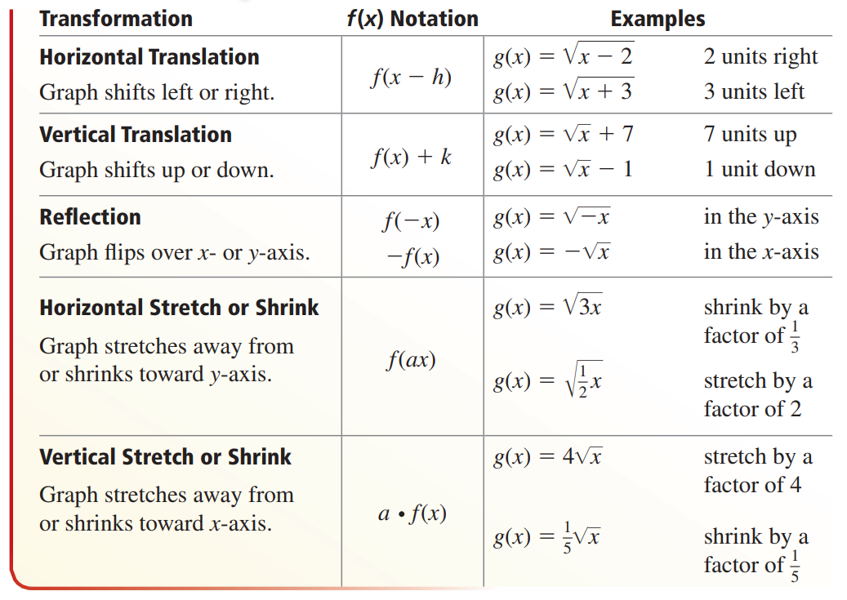
Review of Transformations of Functions
Take a few minutes to review this
Also called
Horizontal Scale
and Vertical Scale

Slide 6
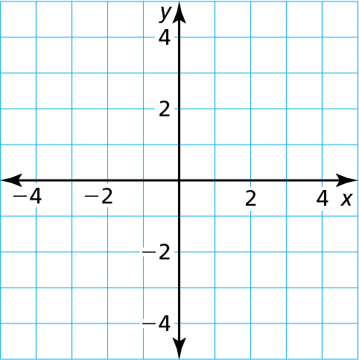
Clarifying note:
Rewriting the inverse variation function showing the exponent may lead some of us to think it is now a direct variation function. That is NOT true!
Remember: a negative exponent really means the variable flips to the “other side” of the fraction so here the $x$ is still in the denominator.
Let’s go back and look at inverse variation functions…
Consider our example from yesterday: $f(x)=\frac{4}{x}$
Have any transformations been applied to it (when compared to its parent function)?
Hint: rewrite $f(x)$ showing the exponent on $x$
$f\left(x\right)=4x^{?}$
What transformation is the 4 (the constant of variation) applying?
$f(x)$ is being scaled vertically (a vertical stretch) by a factor of 4.
Let’s compare the graph of $f(x)$ to its parent function to see what the scale looks like
Here you can see the parent in blue and $f(x)$ in red
You can see that $f(x)$ is pulled out and away from the parent
It is “stretched” away from the “center” of the hyperbola (in this case the origin)
What do you think $g\left(x\right)=\frac{1}{2x}$ would look like, where the scaling factor (shrink) is $\frac{1}{2}$?
You can see it in green …
$$=4x^{−1}$$
It is scaling $f(x)$
f
g
it pulls in (shrinks) toward the “center” of the hyperbola

Slide 7
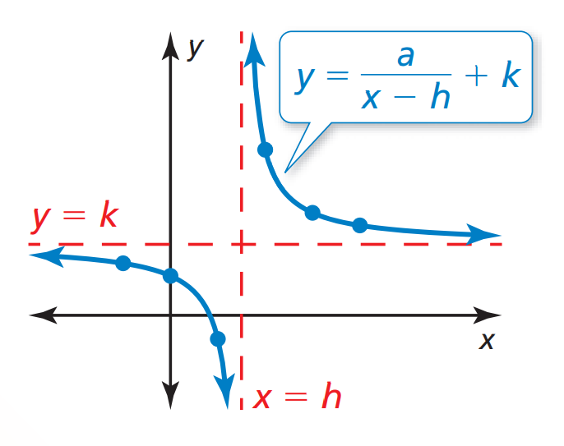
Translations of simple rational functions
We’ve seen what scaling looks like for simple rational functions…
…let’s see what translations (horizontal and vertical shifts) look like.
One quick but important note…
When we translate the function, what do you think happens to the asymptotes?
They translate/shift with the function!
Now it will be necessary to identify and plot the asymptotes
Translated rational functions
Generic form: $y=\frac{a}{x−h}+k$
$h$ is the horizontal shift (subtracting moves right, adding moves left)
$k$ is the vertical shift (adding moves up, subtracting moves down)
Horizontal asymptote: $y=k$
Vertical asymptote: $x=h$
Shifts the “center” of the hyperbola

Slide 8
Update – how to graph rational functions
Draw the asymptotes
If translated:
If not translated:
Plot points to the left and to the right of the vertical asymptote
Pick numbers that are easy to calculate and to plot
If $a$ is negative, the graph will be reflected around the $x$ axis
Connect the dots
Draw the branches so they approach but do not touch the asymptotes
vertical asymptote is $x=h$
, and horizontal asymptote is $y=k$
the $x \& y$ axes are the asymptotes

Slide 9
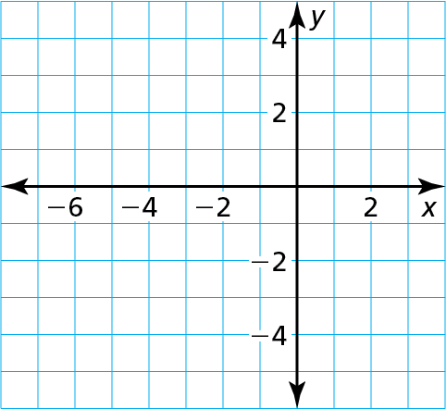
Graph g(x) $=$ $\frac{− \text{4}}{\text{x} + \text{2}}$ $−$ 1. State the domain and range.
SOLUTION
Step 1 Draw the asymptotes x $=$ $−$2 and y $=$ $−$1.
($−$3, 3)
Step 2 Plot points to the left of the vertical asymptote, such as ($−$3, 3), ($−$4, 1), and ($−$6, 0). Plot points to the right of the vertical asymptote, such as ($−$1,$−$5), (0, $−$3), and (2, $−$2).
(−4, 1)
Let f(x) $=$ $\frac{− \text{4}}{\text{x}}$. Notice
that g is of the form
g(x) $=$ f(x $−$ h) $+$ k, where
h $=$ $−$2 and k $=$ $−$1.
So, the graph of g is a
translation 2 units left and 1 unit down of the graph of f.
Also note the reflection over the x-axis since a = -4
($−$6, 0)
(2, $−$2)
($−$1,$−$5)
(0, $−$3)
Step 3 Draw the two branches of the hyperbola so that they pass through the plotted points and approach the asymptotes.
The domain is all real numbers except −2 and the range is all real numbers except $−$1.

Slide 10
Review/Recap
Translations keep coming back…
Make sure you are reviewing these periodically
Once you understand how translations work for a simple function family, the same applies to more complex function types!
Translations for Rational Functions
Inverse variation functions are an example of scaling
Generic form: $y=\frac{a}{x−h}+k$
$h$ is the horizontal shift (subtracting moves right, adding moves left)
$k$ is the vertical shift (adding moves up, subtracting moves down)
Horizontal asymptote: $y=k$
Vertical asymptote: $x=h$
Shifts the “center” of the hyperbola
Khan Academy
I’m not recommending the Khan Academy videos for this stuff, he covers things we are not…
… $a$ (the constant of variation) is the scaling factor

Slide 11
Homework
Pg 370, #11-24

